Slide 1
Lux
Optical Chemical Concentration Analyzer
Creativity & Confidence
www.atikorea.com

Slide 2
Contents
Introduction : Lux
01
Application : DSP
02
Application : SC-1
03
Quality & Reliability
04
New functions
05

Slide 3
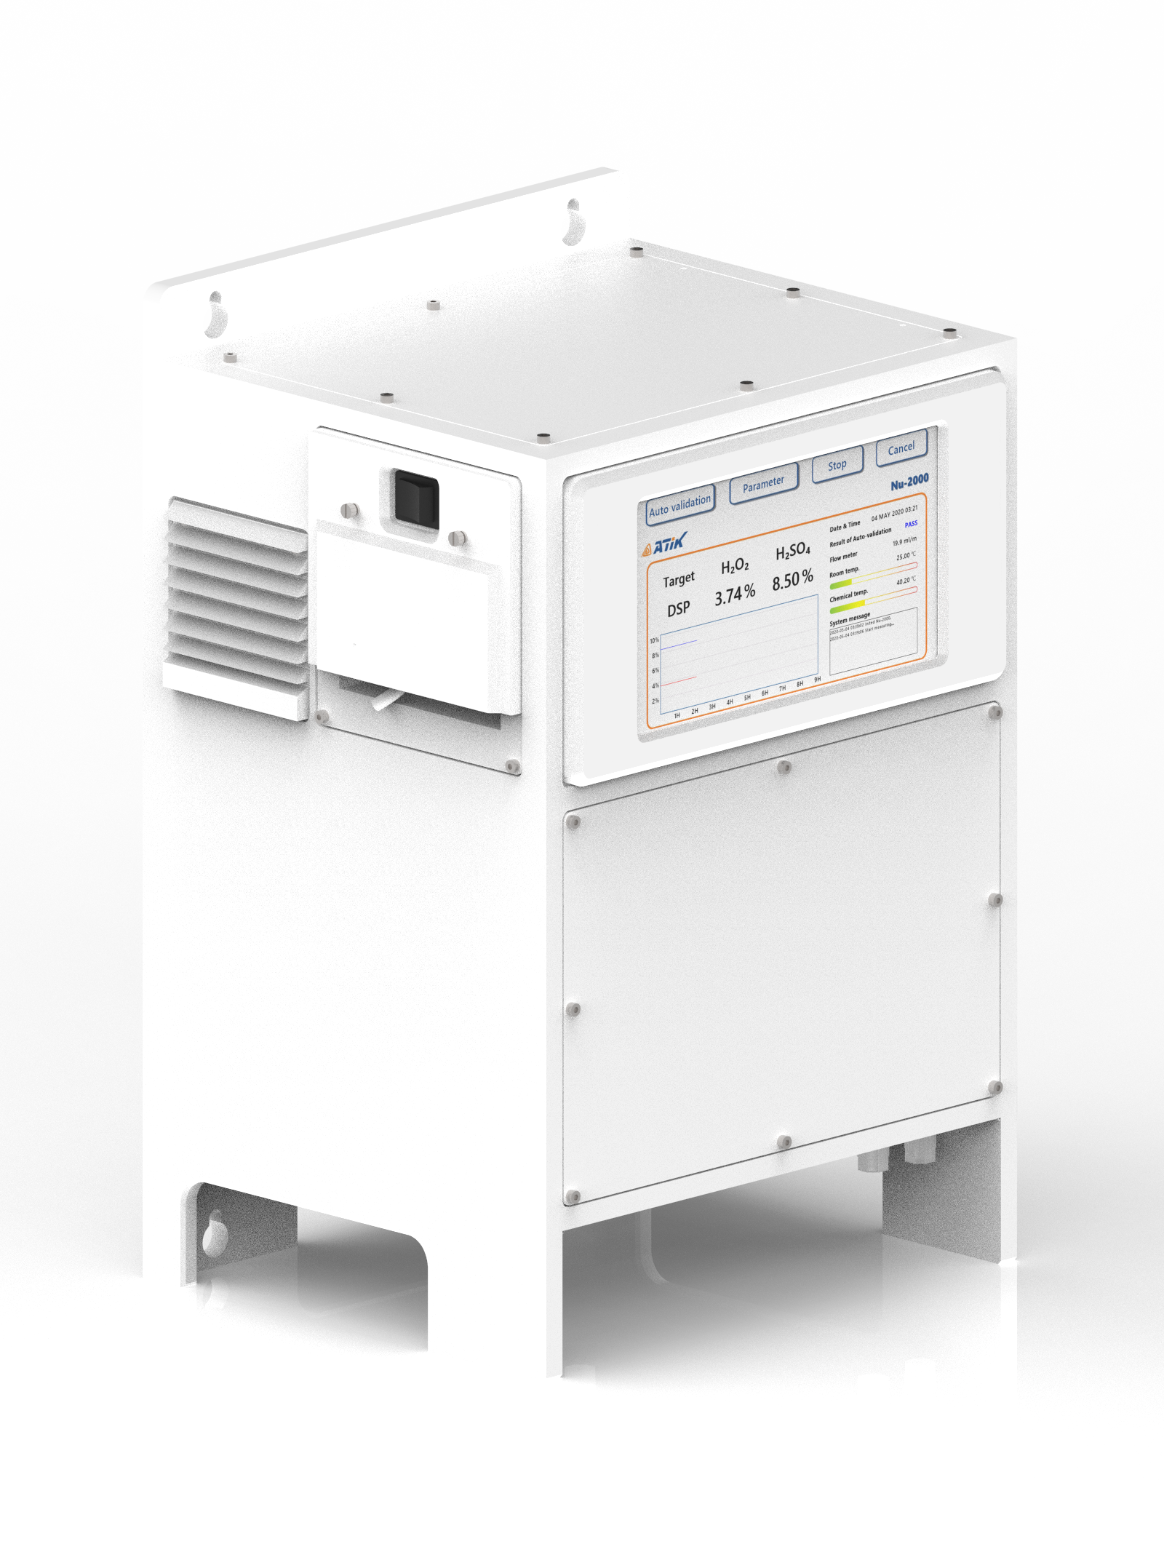
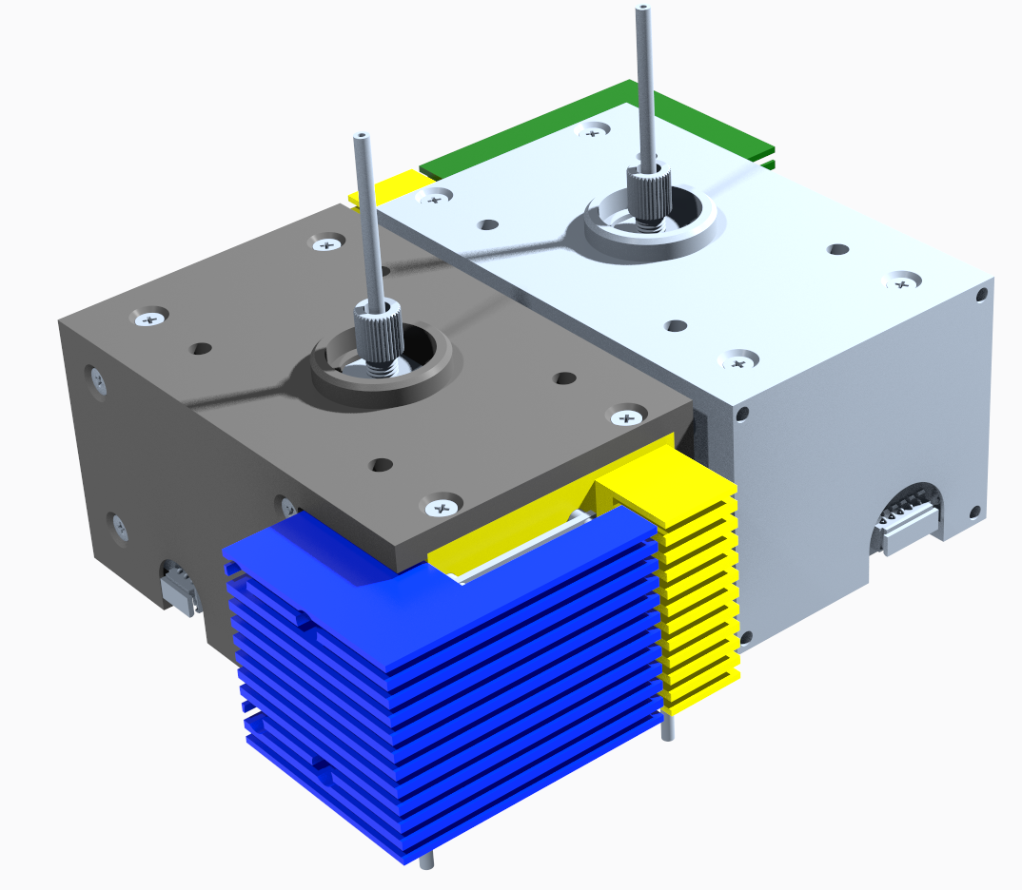
Introduction: Lux
Application
DSP chemical – Hydrogen Peroxide(H₂O₂), Sulfuric Acid(H₂SO₄)
SC-1 chemical - Hydrogen Peroxide(H₂O₂), Ammonia(NH₃)
Etc. – Nitric Acid(HNO₃)
Principle
OAS : Optical Absorption Spectroscopy
Light Source : UV, IR
Size(mm) : 369 x 309 x 540 (WxDxH)
Features
In-line type / real-time monitoring
Auto validation / Auto calibration
Parts life-time monitoring
Repeatability : ±2% of display
Constant Temp. & Flow rate
VOC & Service quick response
Sensor module (UV + IR)

Slide 4
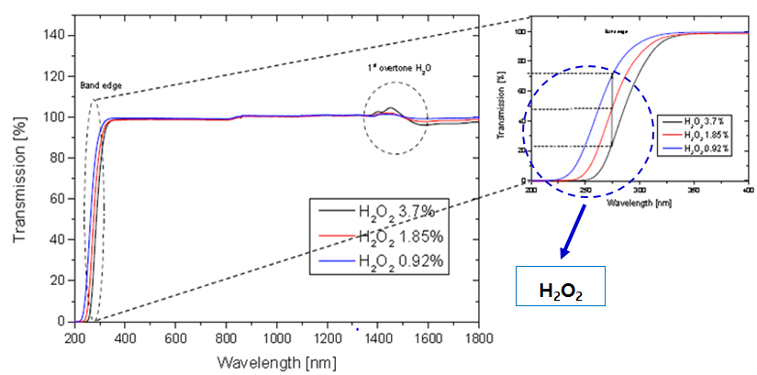
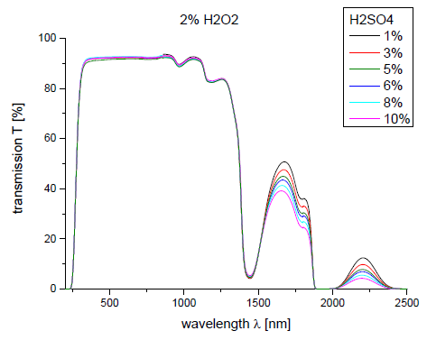
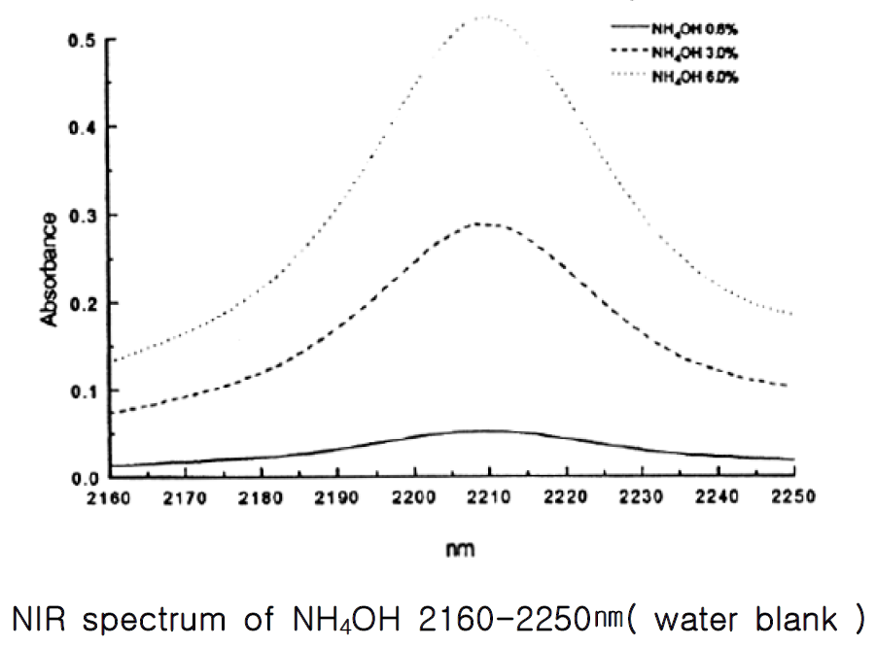
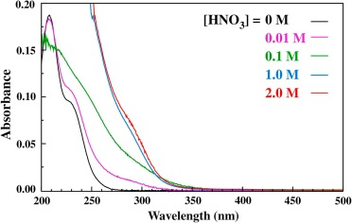
Introduction: Lux
Chemical 고유 흡광 파장 광원 사용
 | Application
Target chemical | SC-1 (H₂O₂ + NH₄OH) | DSP (H₂O₂ + H₂SO₄)
Target concentration | H₂O₂ : 5.43wt% NH₄OH : 1.03wt% | H₂O₂ : 3.7wt% H₂SO₄ : 8.5wt%
Absorption wavelength | H₂O₂ : 280nm (UV) NH₄OH : 2210nm (IR) | H₂O₂ : 280nm (UV) H₂SO₄ : 2200nm (IR)
H₂O₂ (in DSP⁺/SC-1) : UV - 280nm
H₂SO₄ (in DSP⁺) : IR - 2200nm
NH₄OH (in SC-1) : IR - 2210nm
HNO₃ : UV - 280nm
280 nm
2210 nm
2200 nm

Slide 5
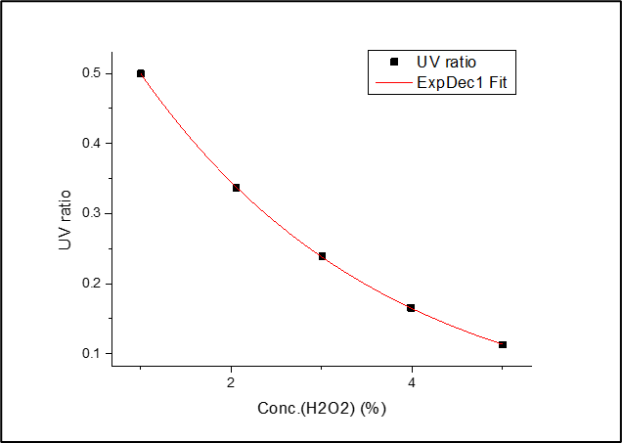
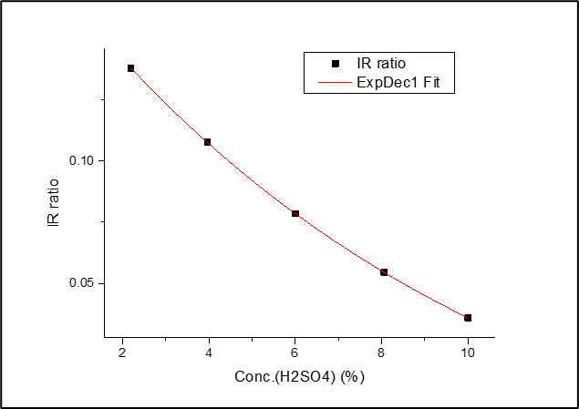
Application: DSP
1. Calibration curve fitting
1.1 Test information
Chemical concentration range
- H₂O₂ : 1/2/3/4/5 (wt%)
- H₂SO₄ : 2/4/6/8/10 (wt%)
측정 시간 – 시료마다 5분
기준 spec. R²≥0.9985
1.2 평가결과
R²=0.99994
R²=0.99999
 | UV (ratio) | IR (ratio)
R² | 0.99994 | 0.99999

Slide 6
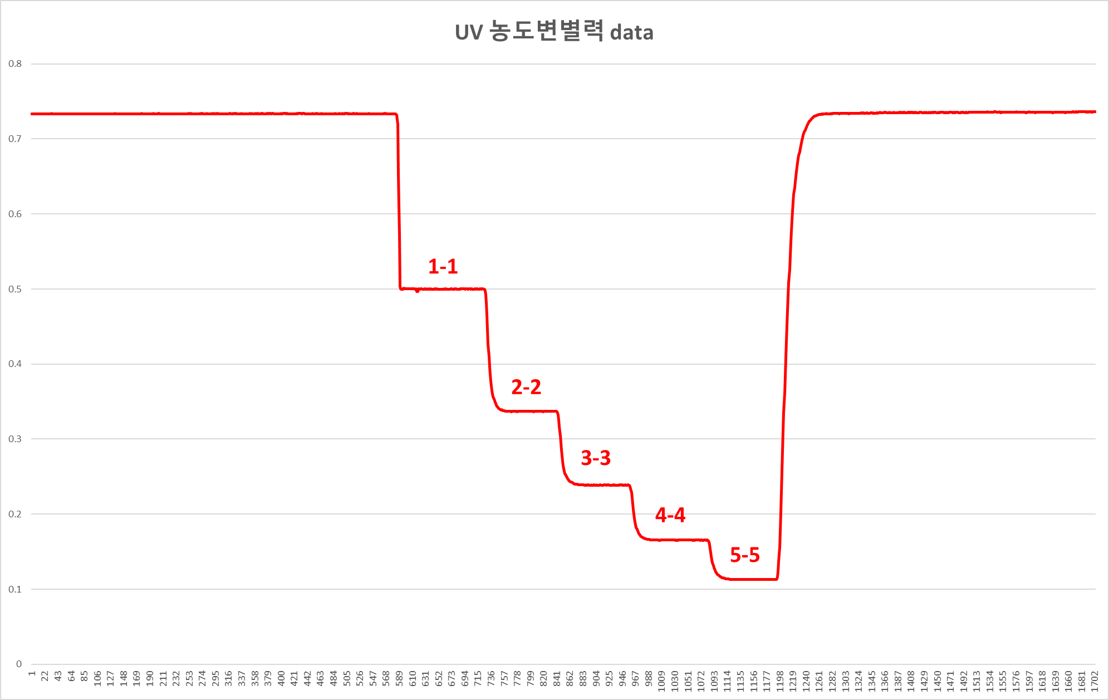
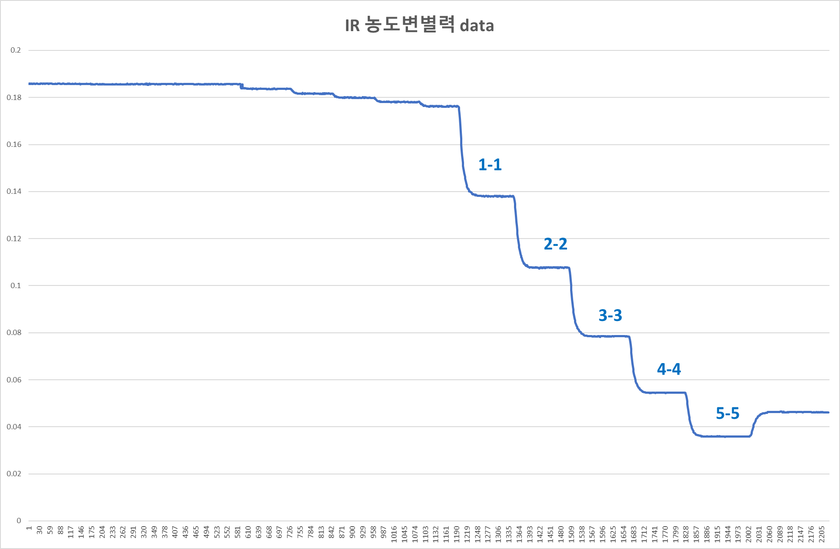
Application: DSP
- 시료 변경구간
2. DSP 농도 변별력 test
2.1 Test information
Target chemical
- H₂O₂ : 1/2/3/4/5 (wt%)
- H₂SO₄ : 2/4/6/8/10 (wt%)
측정 시간 – 시료마다 5분
목표 spec.
- H₂O₂ (wt%) ±0.3%
- H₂SO₄ (wt%) ±0.2%
2.2 평가결과
 | Target conc. |  | Calculation conc.
 | H₂SO₄ | H₂O₂ | H₂SO₄ | H₂O₂
1-1 | 1.000 | 2.195 | 0.997 | 2.196
2-2 | 2.056 | 3.967 | 2.063 | 3.954
3-3 | 3.010 | 6.000 | 2.995 | 5.999
4-4 | 3.991 | 8.058 | 3.984 | 8.055
5-5 | 5.008 | 10.004 | 5.012 | 9.988

Slide 7
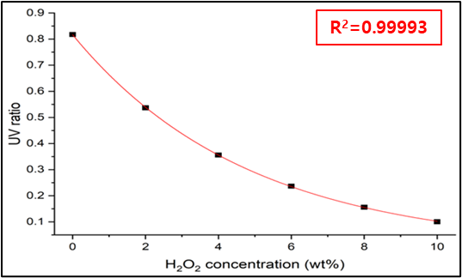
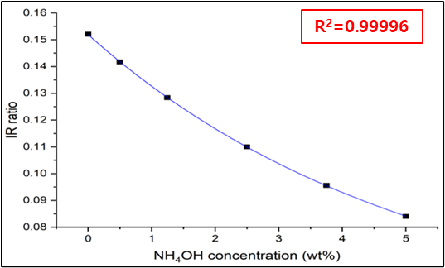
Application: SC-1
1. Calibration curve fitting
1.3 Test information
1.1 Test information
SC-1 농도 25종 calibration curve 작성
SC-1 chemical reaction : UV/IR signal interference
Chemical concentration range
- H₂O₂ : 0/2/4/6/8/10 (wt%)
- NH₄OH : 0/1/2/3/4/5 (wt%)
측정 시간 – 시료마다 5분
기준 spec. R²≥0.98
1.4 평가결과
1.2 평가결과
 | UV (ratio) | IR (ratio)
R² | 0.99993 | 0.99996

Slide 8
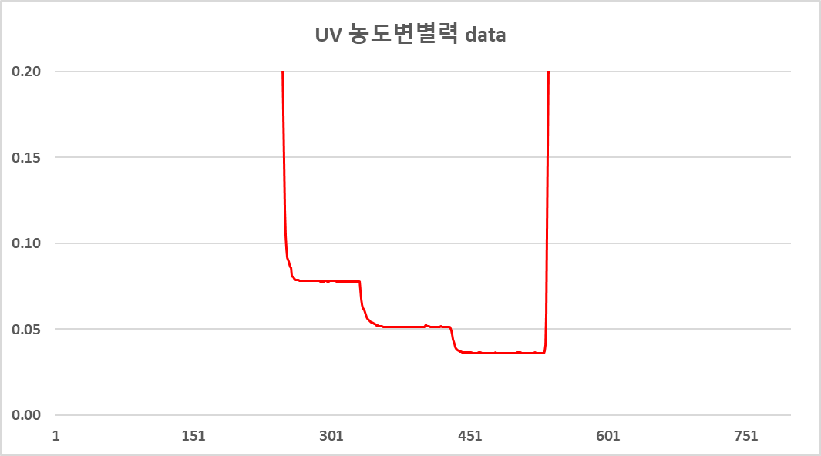
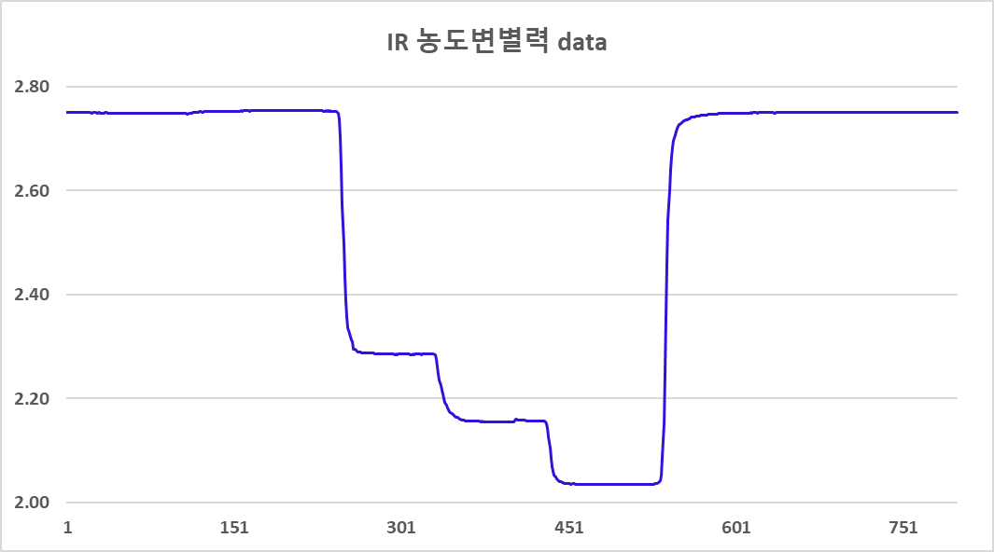
Application: SC-1
- 시료 변경구간
2. SC-1 농도 변별력 test
2.1 Test information
Target chemical
- H₂O₂ : 5.0/5.5/6.0 (wt%)
- NH₄OH : 0.7/1.0/1.3 (wt%)
측정 시간 – 시료마다 5분
목표 spec.
- H₂O₂ (wt%) ±0.3%
- NH₄OH (wt%) ±0.2%
1-1
3-3
5-5
2.2 평가결과
 | Target conc. |  | Calculation conc.
 | NH₄OH | H₂O₂ | NH₄OH | H₂O₂
1-1 | 0.7008 | 5.0004 | 0.7555 | 4.7479
3-3 | 0.9996 | 5.5008 | 1.0725 | 5.4164
5-5 | 1.3004 | 6.0007 | 1.3924 | 5.9415
1-1
3-3
Spec. in
- H₂O₂ conc. error ≤0.3%
- NH₄OH conc. error ≤0.2%
5-5

Slide 9
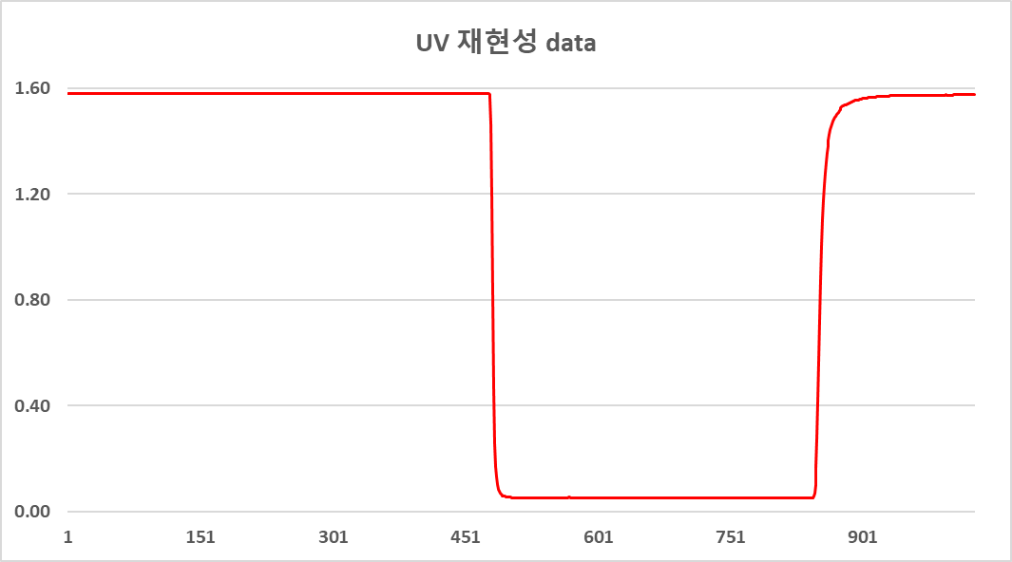
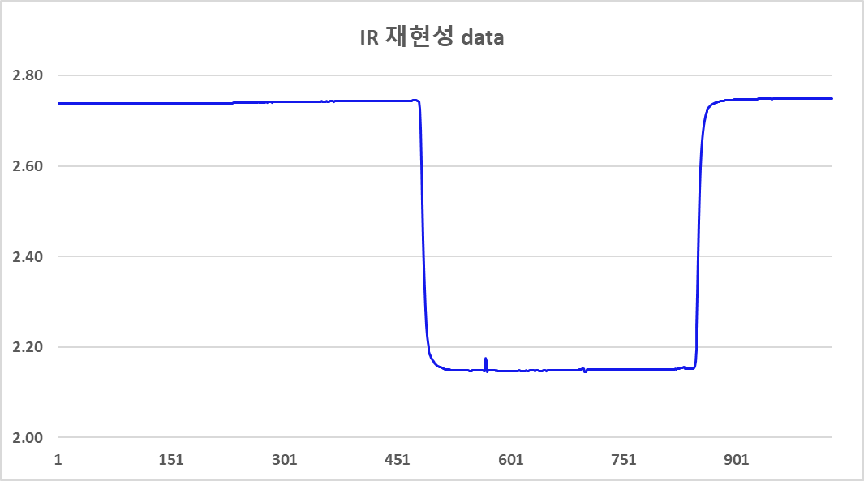
Quality & Reliability
- 시료 변경구간
1. 재현성 test [SC-1]
1.1 Test information
Target chemical: H₂O₂ (5.5 wt%), NH₄OH (1.0 wt%)
측정 시간 – 시료마다 5분
측정 횟수 – 3회 (테스트 전 시료 조제)
목표 spec.
- UV RSD(%)≤2%
- IR RSD(%)≤1%
1차
2차
3차
1.2 평가결과
 | UV (ratio) | IR (ratio)
Average | 0.05074 | 2.14871
STDEV | 0.00004 | 0.00122
RSD(%) | 0.09 | 0.06
동일 농도 반복 측정 시 재현성 확인
재현성 : UV – 0.09%, IR – 0.06% (target : 각 ±2% ±1% 이내)
1차
2차
3차

Slide 10
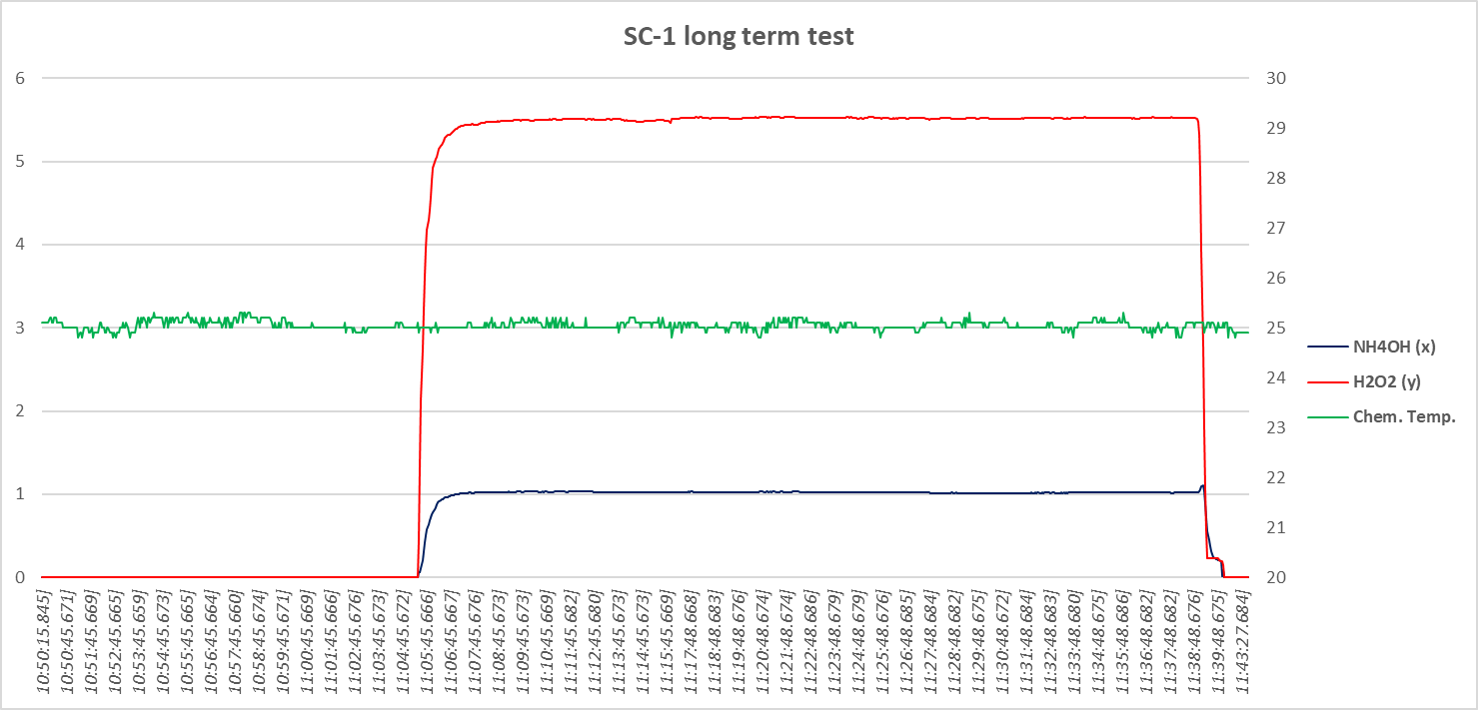
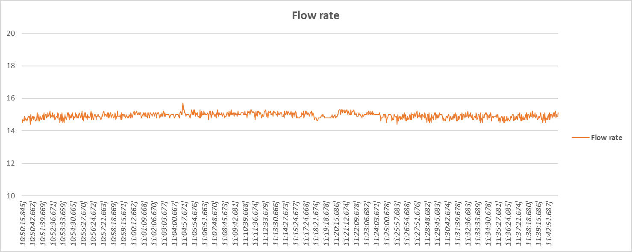
Quality & Reliability
SC-1
2. long-term test [SC-1]
H₂O₂ : conc. 5.51 (wt%), RSD(%) 0.31
2.1 Test information
Target chemical: H₂O₂ (5.5 wt%), NH₄OH (1.0 wt%)
측정 시간 – 30분 (Long-term)
목표 spec.
- UV RSD(%)≤2%, IR RSD(%)≤1%
- H₂O₂ (wt%) ±0.3%, NH₄OH (wt%) ±0.2%
- Flow rate (ml/min) 15 ml/min (±5 ml)
- Chemical temperature (℃) ±5 ℃
Chemical temperature: 25.05 ℃
D.I water
NH₄OH : conc. 1.02 (wt%), RSD(%) 0.51
 | NH₄OH conc. (wt%) | H₂O₂ conc. (wt%) | Chem. Temp. (℃) | Flow rate (ml/min)
Target | 1.00 | 5.50 | 25.00 | 15.00
Average | 1.02 | 5.51 | 25.05 | 14.94
STDEV | 0.01 | 0.02 | 0.08 | 0.17
RSD(%) | 0.51 | 0.31 | 0.31 | 1.14
Flow rate: 14.94 (ml/min)

Slide 11
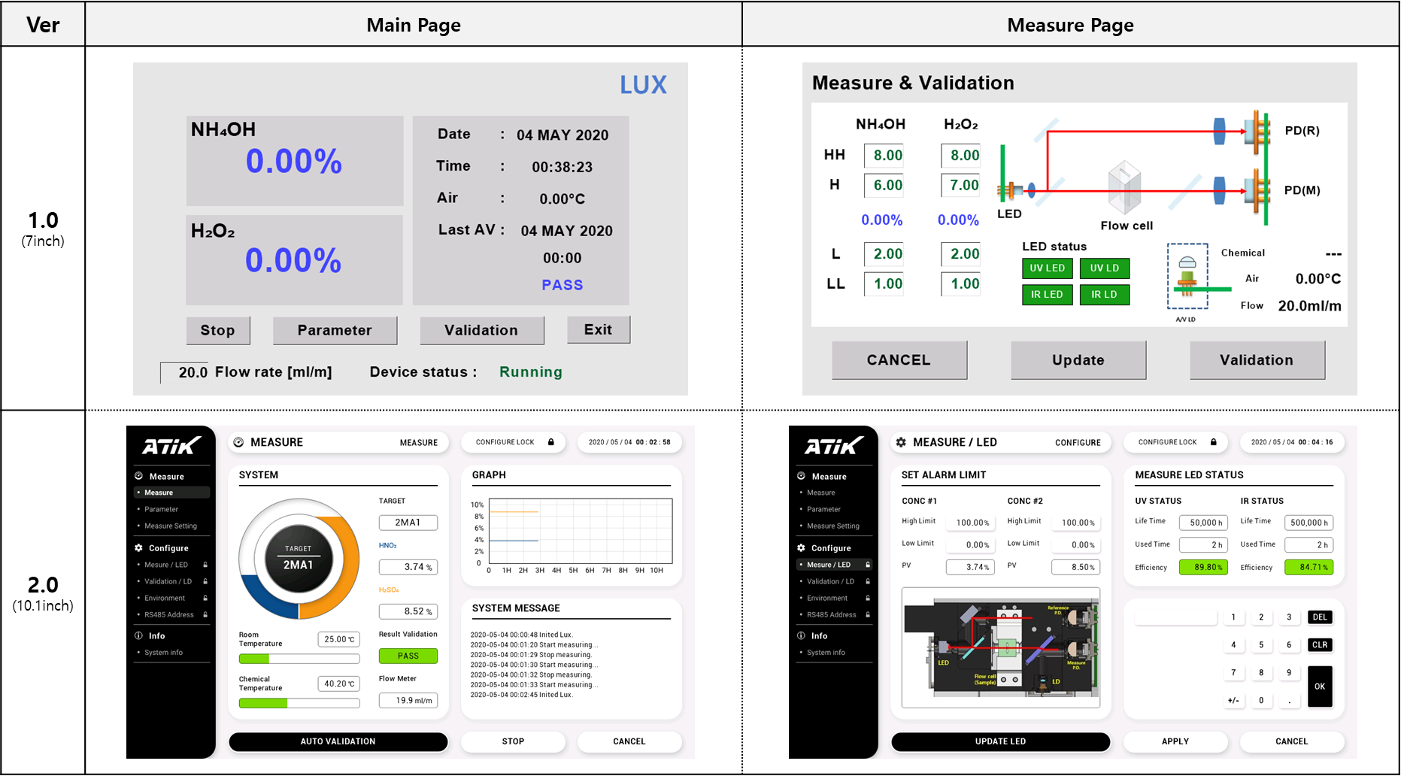
New Function (UI)
Extended Touch LCD screen [7.0’’ → 10.1’’]
UI design version update [UI 1.0 → UI 2.0]

Slide 12
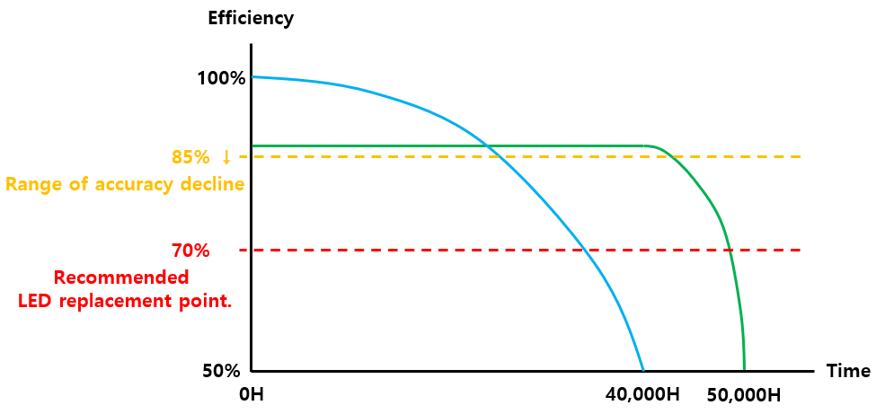
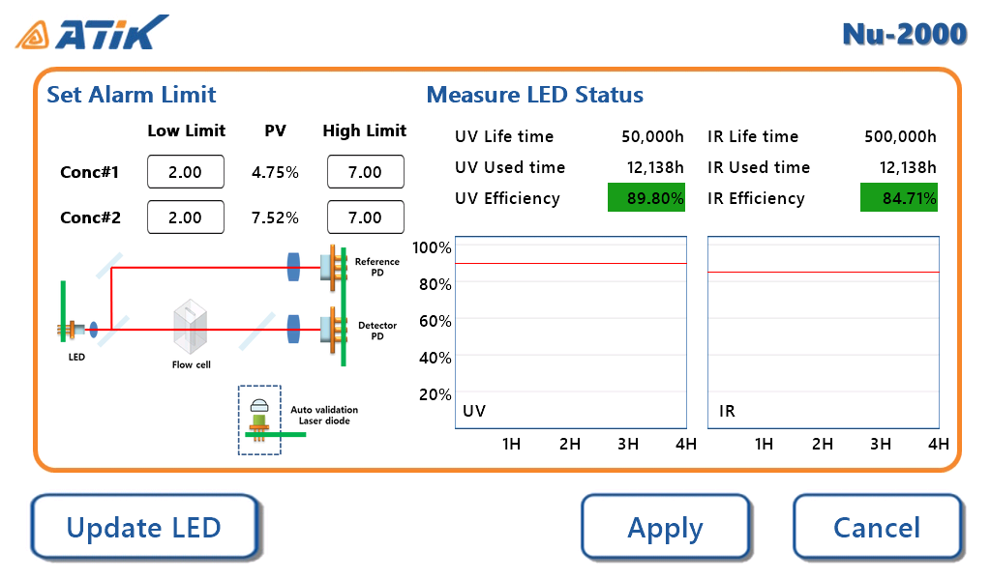
New Function (Auto Calibration & LED life-time)
Auto-calibration for light sources
LED life-time status
Auto-calibration not applied
Auto-calibration applied
 | Standard | Advanced (Auto calibration function)
Life-time | 40,000H | 50,000H
Recommended replacement LED | 27,000H | 47,000H
Range of high accuracy | 18,000H | 45,000H
※ The lifetime can vary depending on the user's equipment usage methods.

Slide 13
Thank you
Creativity & Confidence
www.atikorea.com

